Slide 1
Inference: is the difference
real, or could it be luck?
When two groups differ, how do I know the gap is real and that chance does not explain it?
AI and Data Science Professional | Session 12 of 24 | Module C: Analyse and explain
KLAi Professional Learning | Jotham Martin Wambi
Notes:
Welcome back. A gap between two averages is easy to find. Deciding whether it is luck is the job today. Last session you explored data and found findings worth reporting. Today we test one: did the Lakeside Mart loyalty offer raise how much customers spend?
By the end you will have a confidence interval, a p-value and a decision you can defend, and you will know the two ways these tests mislead people.

Slide 2



Today in one view: what you will leave with
By the end of today you can
Compute and read a standard error, a 95 percent confidence interval and a bootstrap interval
Run and read a permutation test, a Welch two-sample t-test and a test of two proportions, with the null hypothesis and the p-value
Report a decision with its effect size, and avoid false positives from many tests and from stopping early
Notes:
Here is what you can do by the end of today. You can measure how much a sample average varies from one sample to the next, which is sampling variability, and name it with the standard error. You can then build a confidence interval and a bootstrap interval from it.
You can run a permutation test, a t-test and a test of two proportions, and say exactly what a p-value tells you and what it does not. And you can report a decision with its effect size, and you know the two ways these tests mislead people: running many tests, and stopping early when the result looks good. The data is the Lakeside Mart loyalty offer test.

Slide 3

Your two hours: concepts first,
then a Python lab in Colab
Ideas and pictures first. Then you open the notebook and test the offer yourself.
Notes:
We have two hours. The first ten minutes bring back Session 11 and set the question for today. Then forty-five minutes of concepts with laptops closed, because the pictures carry most of the ideas. After a ten minute break you open the notebook in Google Colab for a forty-five minute lab.
You compute the numbers by hand with NumPy, then check them against SciPy. The last ten minutes are an exit check and what you keep. Please protect the lab time.

Slide 4

Three questions from last time
1. Branch B01 has the most returns. Is it the branch with the worst returns problem?
2. What three parts does every finding need?
3. Which chart shows whether two numeric variables move together?
Answer aloud first. Then we check together.
Notes:
Three quick questions from Session 11. Answer aloud first, and then we check together. It is a warm-up to bring last time back.
Question one. Branch B01 has the most returns. Is it the branch with the worst returns problem?
A good answer is this. Not yet known. Divide by lines sold to get the rate: B01 has 1.67 per 100 lines and B07 has 3.18, the highest.
Question two. What three parts does every finding need?
A good answer is this. A number, a comparison and a limit.
Question three. Which chart shows whether two numeric variables move together?
A good answer is this. A scatter plot, drawn with sns.scatterplot. The correlation r puts a number on it.
If you missed one, check your notes from last session tonight. Now to today.

Slide 5



Answers to the three questions from Session 11
Question | Short answer
Branch B01 has the most returns. Is it the branch with the worst returns problem? | Not yet known. Divide by lines sold to get the rate: B01 has 1.67 per 100 lines and B07 has 3.18, the highest.
What three parts does every finding need? | A number, a comparison and a limit.
Which chart shows whether two numeric variables move together? | A scatter plot, drawn with sns.scatterplot. The correlation r puts a number on it.
Notes:
Here are the answers to the three warm-up questions. A branch with the most returns is not necessarily the worst, because a big branch sells more. Divide returns by lines sold to get the rate. Branch B01 has the most returns and the lowest rate, and B07 has the highest rate.
Every finding needs a number, a comparison and a limit. And a scatter plot, drawn with seaborn scatterplot, shows whether two numeric variables move together. Today we add one more habit to the finding: before you report a gap, ask whether it could be luck. Which of the three would you answer differently now?

Slide 6




Words we use today
Word | What it means
Standard error (SE) | How much a sample mean varies from one random sample to the next. It is the standard deviation divided by the square root of the sample size.
Confidence interval (CI) | A range built from the data. A 95 percent interval is the estimate plus or minus 1.96 standard errors.
Null hypothesis (H0) and p-value | H0 says there is no real difference. The p-value says how often chance alone would give a gap at least this big if H0 were true.
Effect size | How big the gap is, in units a person can feel, such as shillings or percent. Practical significance asks whether that size matters.
False positive (Type I error) | Declaring a difference when there is none. Running many tests, or stopping early, makes it far more likely.
Notes:
Five words for today. I give the plain meaning of each, and we use every one of them before the end of the session.
Standard error (SE). How much a sample mean varies from one random sample to the next. It is the standard deviation divided by the square root of the sample size.
Confidence interval (CI). A range built from the data. A 95 percent interval is the estimate plus or minus 1.96 standard errors.
Null hypothesis (H0) and p-value. H0 says there is no real difference. The p-value says how often chance alone would give a gap at least this big if H0 were true.
Effect size. How big the gap is, in units a person can feel, such as shillings or percent. Practical significance asks whether that size matters.
False positive (Type I error). Declaring a difference when there is none. Running many tests, or stopping early, makes it far more likely.

Slide 7
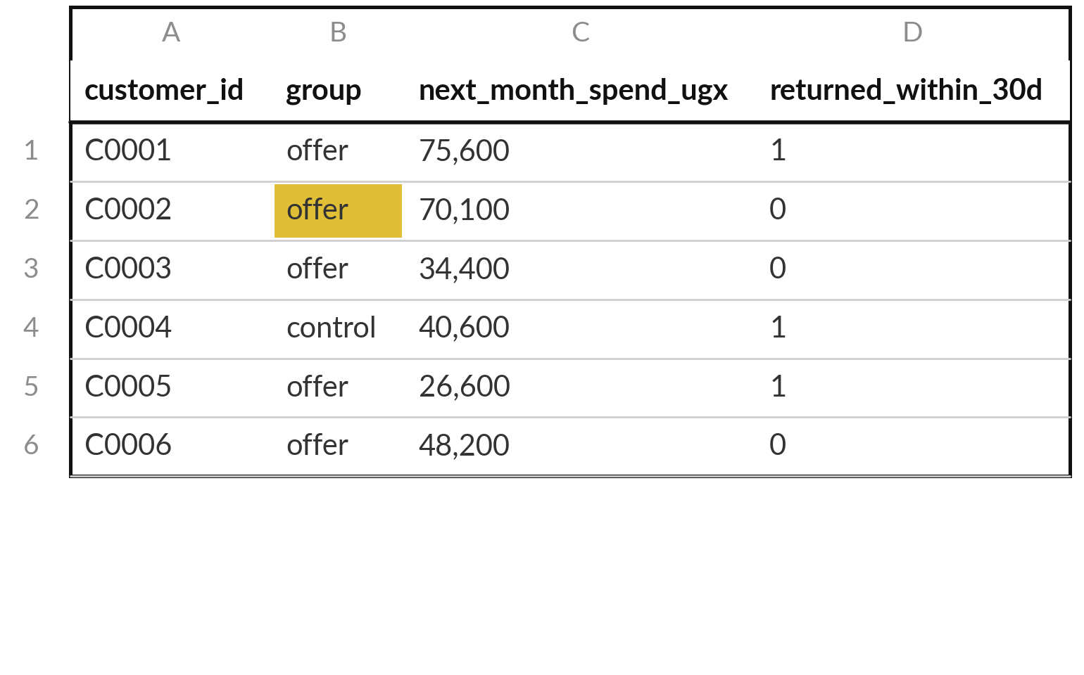
An A/B test: chance decides who gets the
offer (treatment) and who does not (control)
Random assignment makes the groups alike on average in everything except the offer.
Each record is one loyalty customer.
1,245 got the offer (treatment). 1,255 did not (control).
The outcome is next month spend.
Notes:
Today the question comes from a manager. We gave a loyalty offer to some customers. Did it work?
The test was set up by chance. Lakeside Mart took 2,500 loyalty customers and gave a random half the offer. That is an A/B test, a controlled experiment. The 1,245 customers who got the offer are the treatment group, and the 1,255 who did not are the control group.
Because chance chose who got what, the two groups should be alike on average in everything except the offer, and the larger the groups the better this works. Each record is one customer. The outcome we look at is the spend in the next month. Why does random assignment matter so much?

Slide 8
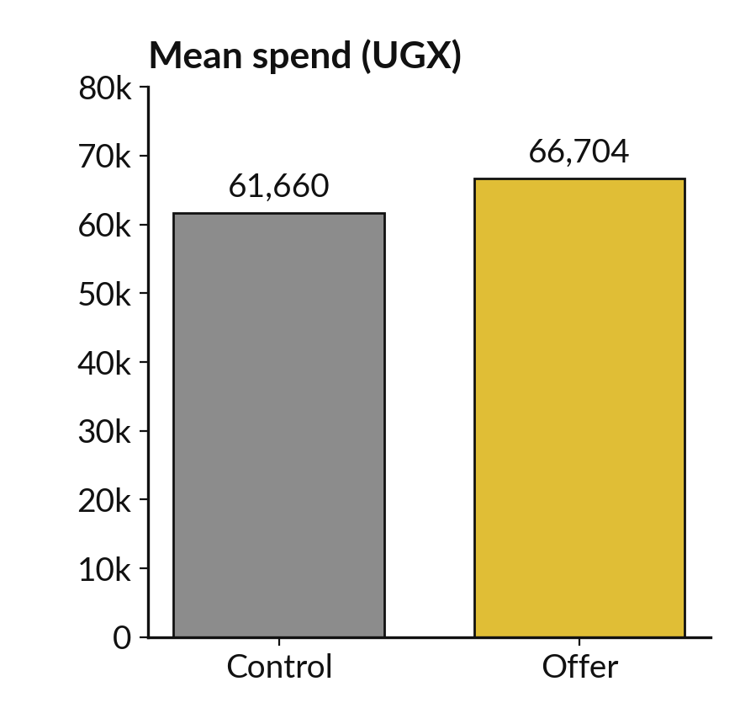
The lift in average spend is 5,044
UGX. Is it the offer, or luck?
5,044
UGX more per customer in the treatment group: a mean of 66,704 against 61,660 in the control group. The lift is the treatment mean minus the control mean.
Notes:
Here is the result. Offer customers spent 66,704 shillings next month on average, and control customers spent 61,660. The difference is 5,044 shillings, which we call the lift: the treatment mean minus the control mean. That is 8.2 percent more than the control mean. The question for the manager is whether the 5,044 comes from the offer or from the luck of who landed in which group.
To judge luck we first need to measure how much a sample mean varies from one sample to the next. What do you think moves more, a mean of ten customers or a mean of a thousand?

Slide 9
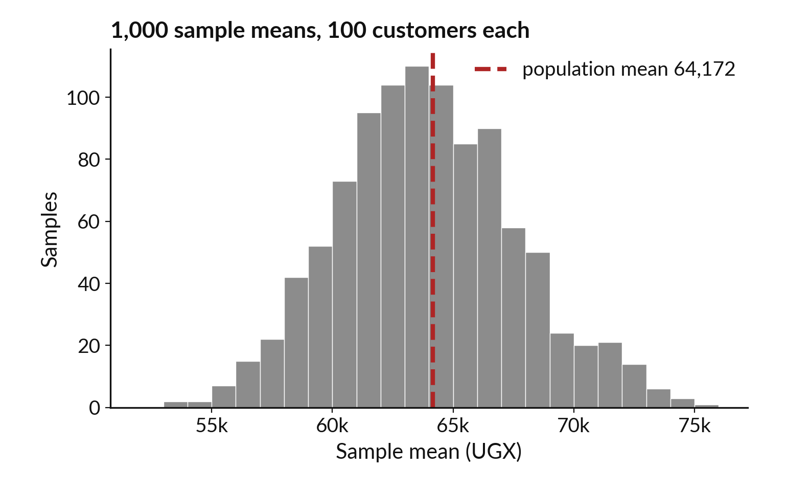
Sampling variability: every random
sample gives a slightly different mean
A sample mean is an estimate of the population mean. Its spread is the standard error.
Population: all 2,500 customers. Sample: 100 drawn at random, with replacement.
The 1,000 means range from 53,306 to 75,316.
Their standard deviation, 3,736, is the standard error.
Notes:
To judge a gap we need to see how much a sample mean varies. For this picture we treat all 2,500 customers as the population. A sample is a smaller group drawn from it. We draw 100 customers at random, with replacement, find their mean spend, and repeat that a thousand times.
This is a Monte Carlo simulation. Each bar counts how many samples gave a mean in that range. The means run from 53,306 to 75,316, around the population mean of 64,172. That spread is called sampling variability, and its standard deviation, 3,736 shillings, is the standard error. Any one sample is only an estimate.
Which sample would you have trusted?

Slide 10
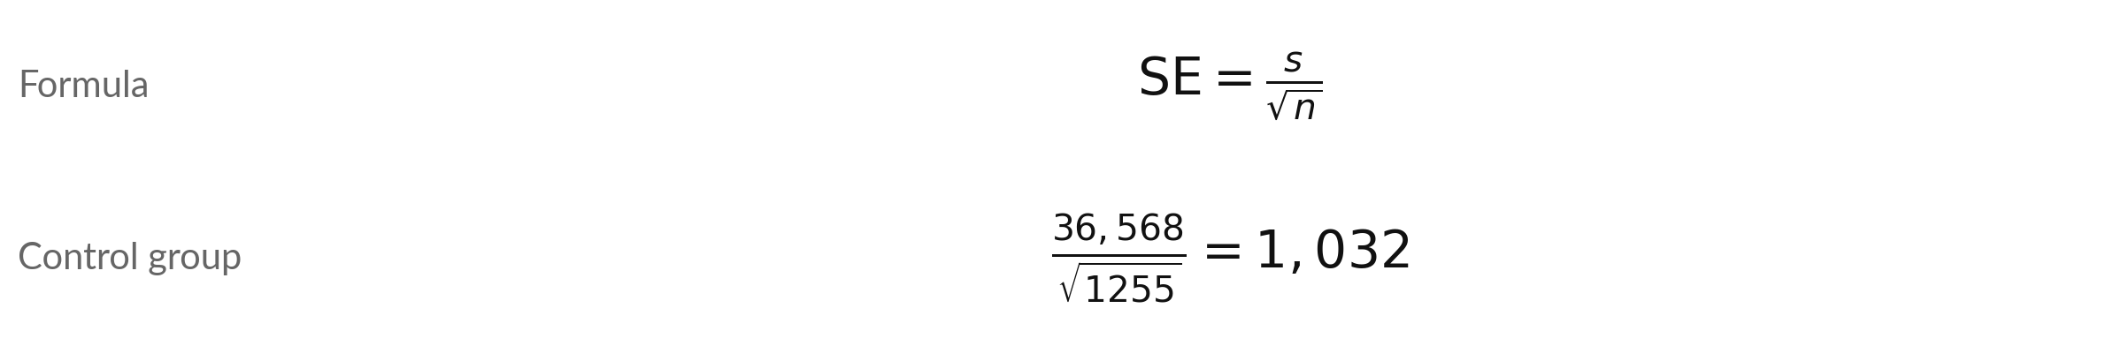
The standard error of a mean is the standard
deviation divided by the square root of n
Symbol | What it means | In our data
SE | The standard error: the typical distance of a sample mean from the population mean. | 1,032 UGX
s | The sample standard deviation (ddof=1): the spread of customers. | 36,568 UGX
n | The sample size: how many customers. | 1,255 control customers
Excel: =STDEV.S(range)/SQRT(COUNT(range)). NumPy: x.std(ddof=1) / np.sqrt(len(x)).
Notes:
You do not have to simulate the standard error. There is a formula. The standard error equals the sample standard deviation, s, divided by the square root of the sample size, n. For the control group the standard deviation is 36,568 shillings and there are 1255 customers. The square root of 1255 is about 35.4, and the division gives 1,032.
The check on the slide compares the simulation with the formula for samples of 100: the simulation gave 3,736 and the formula gives 3,820. They agree. In Excel this is STDEV.S divided by the square root of COUNT. What happens to the standard error when n gets bigger?

Slide 11
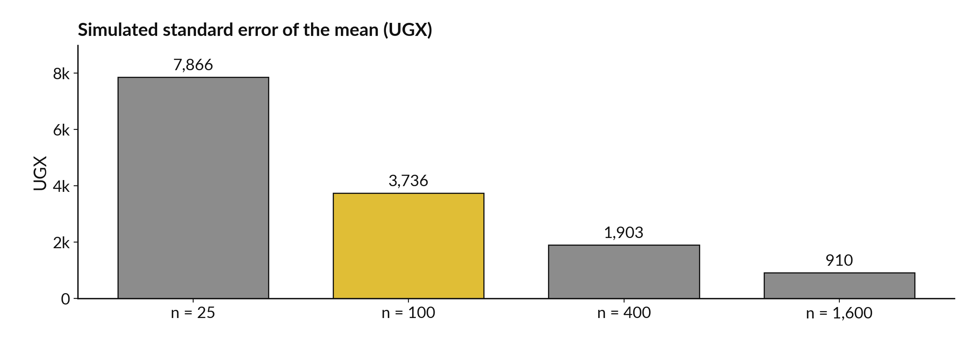
A bigger sample has a smaller standard
error: four times the customers halves it
Formula values: 7,640, 3,820, 1,910, 955. Each bar is 1,000 samples with replacement.
Notes:
Here is the same experiment with four sample sizes. With 25 customers in each sample the standard error is about 7,866 shillings. With 100 it is 3,736. With 400 it is 1,903, and with 1,600 it is 910. Each time we multiply the sample by four, the standard error falls to about half.
That is the square root in the formula at work. It also explains why a test with 2,500 customers can say more than a test with 50. The price is that halving the error costs four times the data. Is that worth it for a test that costs money to run?

Slide 12
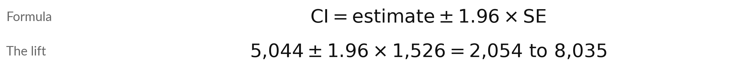
A 95 percent confidence interval is the
estimate plus or minus 1.96 standard errors
Symbol | What it means | In our data
estimate | The number from the sample. Here the lift. | 5,044 UGX
SE | The standard error of the lift: the square root of the two squared standard errors added. | 1,526 UGX
1.96 | The critical value for a 95 percent confidence level, from the normal distribution. | 95 percent
CI | The interval. It excludes zero when the lift is clearly above or below zero. | 2,054 to 8,035
Each group alone: control CI 59,636 to 63,683. Offer CI 64,502 to 68,906.
Notes:
A confidence interval is built from the standard error. For a 95 percent interval, take the estimate and go 1.96 standard errors below and above it. The number 1.96 comes from the normal distribution, and 95 percent is the confidence level. Our estimate is the lift, 5,044 shillings.
The standard error of the lift combines the errors of the two groups: the square root of the sum of their squared standard errors, which is 1,526. So the interval runs from 2,054 to 8,035 shillings. It does not include zero. That is the first evidence of a lift.
What would zero inside the interval have told us?

Slide 13
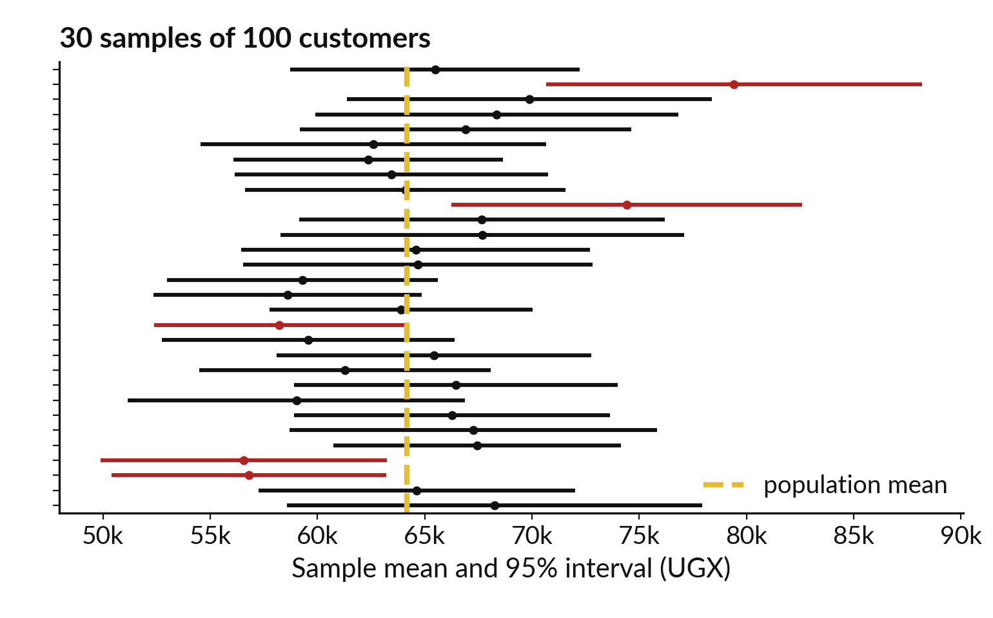
What 95 percent means: it describes the
method over many samples, not one interval
Draw many samples. About 95 in 100 intervals catch the population mean.
25 of these 30 intervals catch it. The red ones miss.
Over 1,000 samples, 93.9 percent did.
Spend is skewed, so small samples fall a little short of 95.
Notes:
This is the most misread idea in statistics. A 95 percent confidence interval describes the method and makes no promise about one interval. We drew 1,000 samples of 100 customers, and built an interval from each. Here are the first 30. The gold line is the true population mean, which we know here.
25 of these 30 intervals catch it, and the red ones miss. Over all 1,000 samples, 93.9 percent caught it. That is close to 95, a little short because spend is skewed and each sample is small. So when you report one interval, you are using a method that catches the truth about 95 times in 100.
Does the picture show that any single interval is guaranteed to catch it?

Slide 14
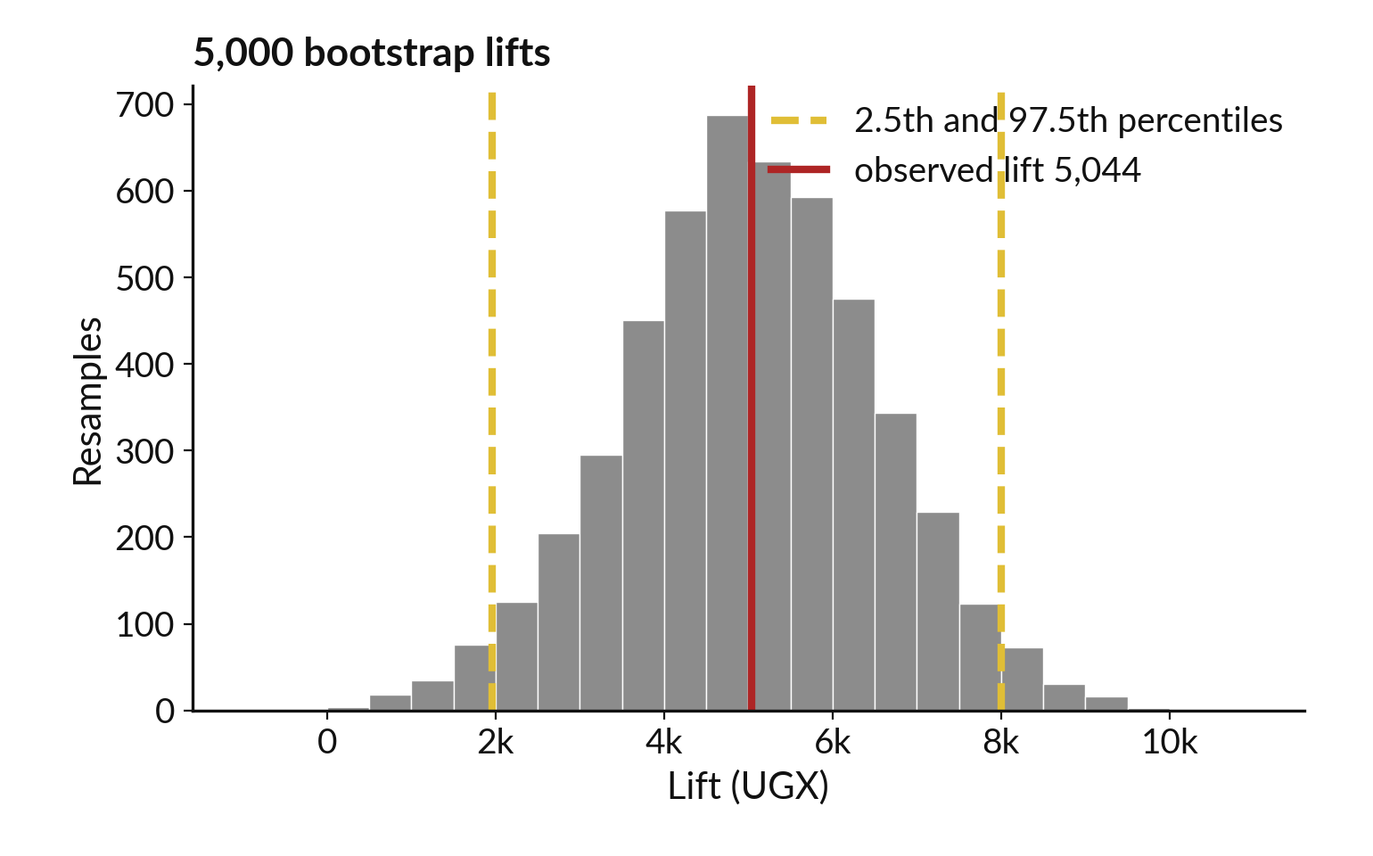
The bootstrap resamples your own data to
measure sampling variability without a formula
Bootstrap: resample each group with replacement, same size, and recompute the lift. Repeat 5,000 times.
The spread of the 5,000 lifts is 1,522, close to the formula SE 1,526.
Percentile interval: 1,959 to 8,004.
It needs no formula, so it works for medians too.
Notes:
The bootstrap is a way to measure the sampling variability from the data you already have. Pretend your sample is the whole world. Draw a new sample of the same size from it, with replacement, so a customer can appear twice. Do that for the offer group and for the control group, and compute the lift.
Repeat 5,000 times, with a fixed random seed so the numbers repeat. The 5,000 lifts form this picture. Their standard deviation is 1,522, close to the formula answer of 1,526. Cut off the lowest 2.5 percent and the highest 2.5 percent, and the ends are 1,959 and 8,004.
That is the bootstrap percentile interval, and it agrees with the formula interval. Where would a bootstrap help when no formula exists?

Slide 15






A hypothesis test asks: how surprising
are the data if nothing is going on?
Term | Plain meaning | In the offer test
Null hypothesis (H0) | There is no real difference. Any gap is chance. | The offer does not change average spend.
Alternative hypothesis (H1) | There is a real difference. | The offer changes average spend.
Test statistic | One number that measures the gap against the noise. | The lift, or t = 3.31
p-value | How often chance alone gives a gap at least this big, if H0 is true. | About 0.00096 (see the next slides)
Significance level (alpha) | The threshold chosen before the test. Usually 0.05. | alpha = 0.05
Decision | p below alpha: reject H0. Otherwise, keep H0. | 0.00096 is below 0.05: reject H0
Notes:
Now the logic of a hypothesis test. Start by assuming that nothing is going on. That assumption is the null hypothesis, H0: the offer does not change average spend. The alternative hypothesis, H1, says it does. Then compute a test statistic, one number that measures the gap against the noise.
The p-value answers a precise question: if H0 were true, how often would chance alone give a gap at least this big?
Before the test we choose a threshold called the significance level, alpha, usually 0.05. If the p-value is below alpha, we reject H0. For our test the p-value is about 0.00096, so we reject it. Why do we fix alpha before looking at the data?

Slide 16
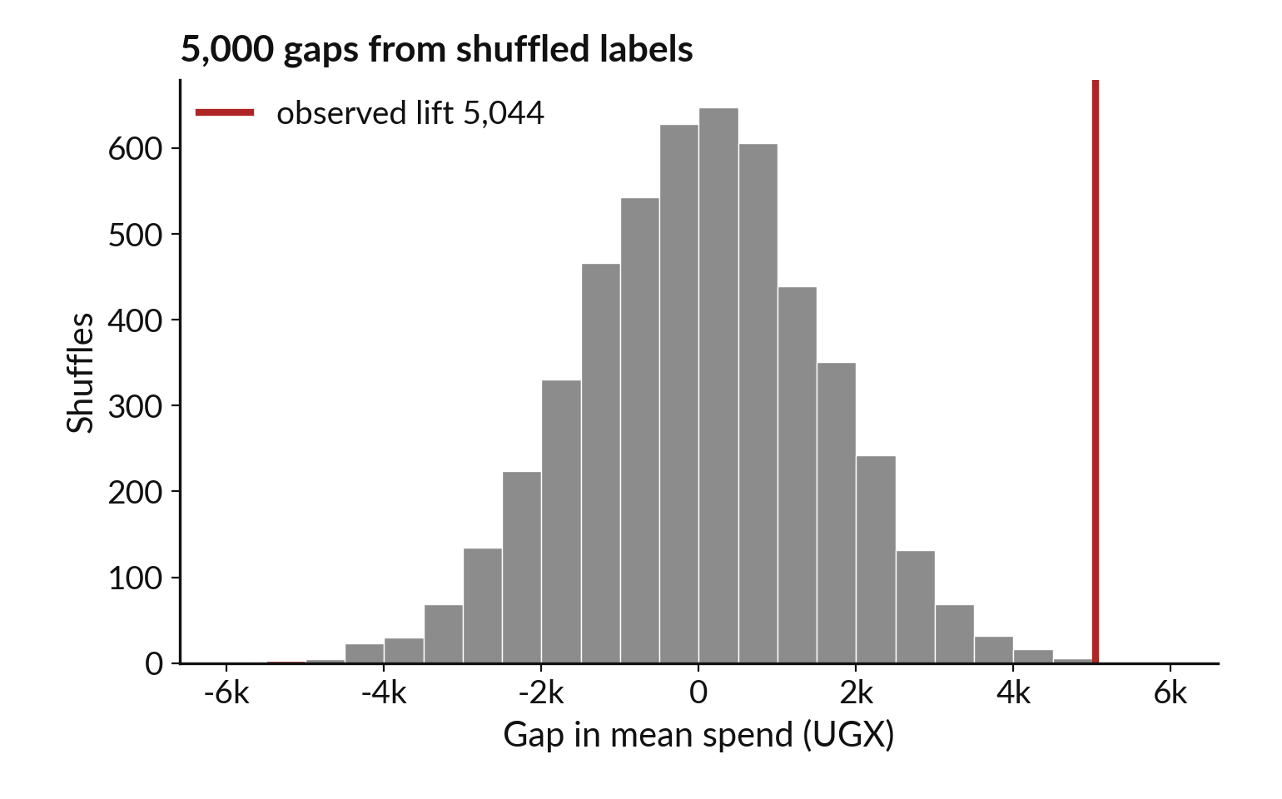
A permutation test shuffles the group
labels to see what chance alone produces
Shuffle offer and control labels at random. If H0 is true, the labels carry no information.
Only 7 of 5,000 shuffled gaps were as big as 5,044 (red).
p = 7 / 5,000 = 0.0014, or 8 / 5,001 = 0.0016.
The p-value is the share of shuffles at least as extreme.
Notes:
Here is a test you can do with no formula at all. If the offer has no effect, then which customers are labelled offer and which control is arbitrary. So we shuffle the labels at random, keeping the group sizes, and compute the gap in mean spend. We do that 5,000 times.
The histogram shows the gaps that chance alone produces. They centre on zero and spread about 1,547 either way. The red bars are shuffles with a gap at least as big as ours, in either direction. Only 7 of 5,000 reached that size, so the p-value is 7 divided by 5,000, which is 0.0014.
Many analysts report 8 over 5,001, which is 0.0016, so that p is never exactly zero. Why do we count both directions?

Slide 17
A p-value is easy to misread: know
what it says and what it does not
It says
It does not say
If H0 were true, data this extreme would be rare: p = 0.00096.
The probability that H0 is true.
How big the effect is.
That the result will repeat.
A small p-value is evidence against H0. Effect size tells you how much it matters.
Notes:
A p-value is easy to misread. It says one thing: if the null hypothesis were true, data as extreme as ours would be rare. Our p-value is 0.00096. It does not say the probability that the null hypothesis is true. It does not say how big or important the effect is, because a huge sample can give a tiny p-value for a tiny gap.
And it does not promise the result will repeat. A small p-value is evidence against H0, and the effect size tells you how much it matters. Which of these misreadings have you heard in a meeting?

Slide 18
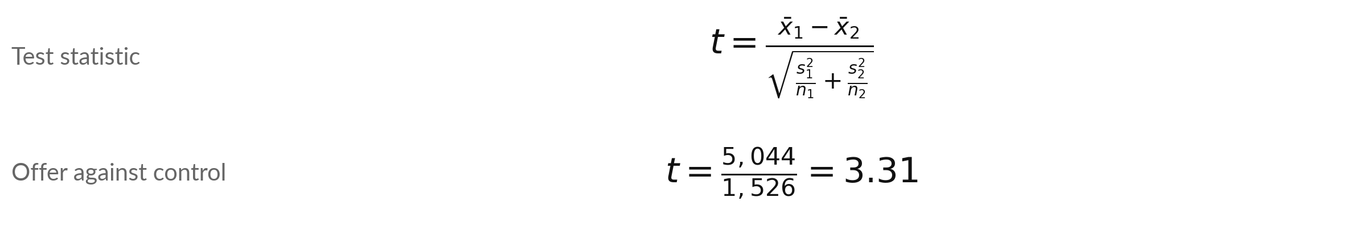
Welch's two-sample t-test: the
lift divided by its standard error
Symbol | What it means | In our data
x-bar 1, x-bar 2 | The two group means. | 66,704 and 61,660
s, n | Standard deviation and size of each group. Welch lets the two spreads differ. | 39,649, 1,245 and 36,568, 1,255
df and p-value | Welch-Satterthwaite degrees of freedom, and the two-sided p-value from the t distribution. | 2478.5 and 0.00096
SciPy: stats.ttest_ind(offer, control, equal_var=False) gives the same t and p-value.
Notes:
The Welch two-sample t-test is the standard test for a gap between two means. The test statistic t is the difference in means divided by its standard error, so it counts how many standard errors the lift is from zero. Here t is 5,044 divided by 1,526, which is 3.31.
Welch means we do not assume the two groups have the same spread. The degrees of freedom, 2478.5, come from the Welch-Satterthwaite formula. The two-sided p-value from the t distribution is 0.00096. SciPy computes the same statistic with ttest underscore ind and equal underscore var equal False. We computed this one by hand with NumPy.
Why is a t of 3.3 convincing?

Slide 19
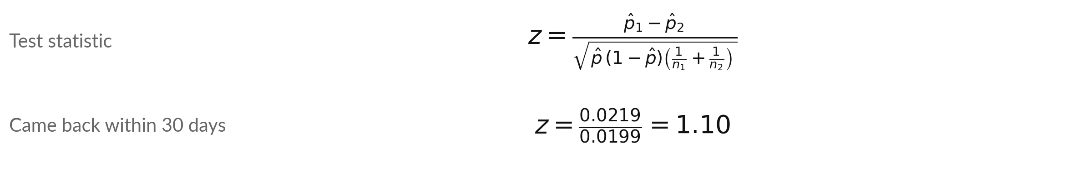
A test of two proportions asks the
same question for a yes or no outcome
Symbol | What it means | In our data
p-hat 1, p-hat 2 | The share who returned within 30 days in each group. | 0.4514 and 0.4295
p-hat | The pooled share: all returners over all customers. It is the rate if H0 is true. | 0.4404
z and p-value | The test statistic, and the two-sided p-value from the normal distribution. | 1.10 and 0.27
statsmodels proportions_ztest gives the same z. This z uses the pooled share. The interval after it does not.
Notes:
The second question from the manager was whether more customers came back within 30 days. That outcome is a yes or no, so we compare two proportions. 562 of 1,245 offer customers returned, a share of 0.4514. 539 of 1,255 control customers returned, 0.4295. The gap is 0.0219.
Under the null hypothesis both groups share one rate, the pooled share 0.4404, and that gives the standard error. The statistic z is 1.10 and the p-value is 0.27. That is far above 0.05, so we cannot reject the null hypothesis. The statsmodels function proportions underscore ztest computes the same z.
Does this mean the offer does not bring customers back?

Slide 20
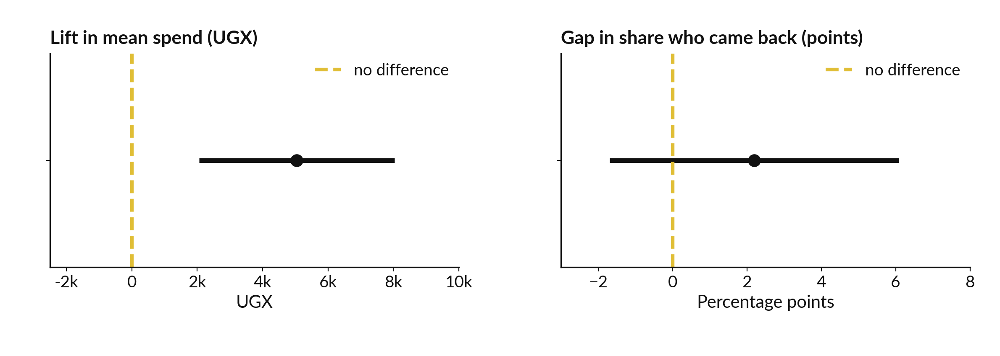
The spend interval stays above zero.
The return-rate interval crosses zero.
Spend: 2,054 to 8,035. Return rate: -1.7 to 6.1 points. 95 percent intervals, formula method.
Notes:
Here are the two results as intervals. On the left, the lift in mean spend, 5,044 shillings, with a 95 percent interval from 2,054 to 8,035. The whole interval is above zero, the gold dashed line, so the offer raised spend. On the right, the gap in the share of customers who came back, 2.2 percentage points, with an interval from -1.7 to 6.1.
That interval crosses zero. The data are compatible with a small gain, with no change, and with a small loss. The interval is often more useful than the p-value, because it shows the range of plausible effects. Which of the two would you act on?

Slide 21


Two questions, two different answers
Question | Estimate and 95% interval | p-value | Decision
Did the offer raise next-month spend? | +5,044 UGX (2,054 to 8,035) | 0.00096 | Reject H0. Strong evidence of a lift.
Did more customers come back within 30 days? | +2.2 points (-1.7 to 6.1) | 0.27 | Keep H0. No evidence of a change.
Not rejecting H0 is different from proving the offer has no effect on returning. The interval is wide, and more customers could narrow it.
Notes:
Putting the two together. For spend, the estimate is plus 5,044 shillings, the interval is 2,054 to 8,035, and the p-value is 0.00096. We reject the null hypothesis, because chance alone would rarely give a gap this big. For coming back within 30 days, the estimate is plus 2.2 points, the interval runs from -1.7 to 6.1, and the p-value is 0.27.
We keep the null hypothesis. But keeping it is different from proving there is no effect. The interval is wide, so a small gain is still possible. The honest sentence is that we found no evidence of a change. How would you word that for a manager?

Slide 22
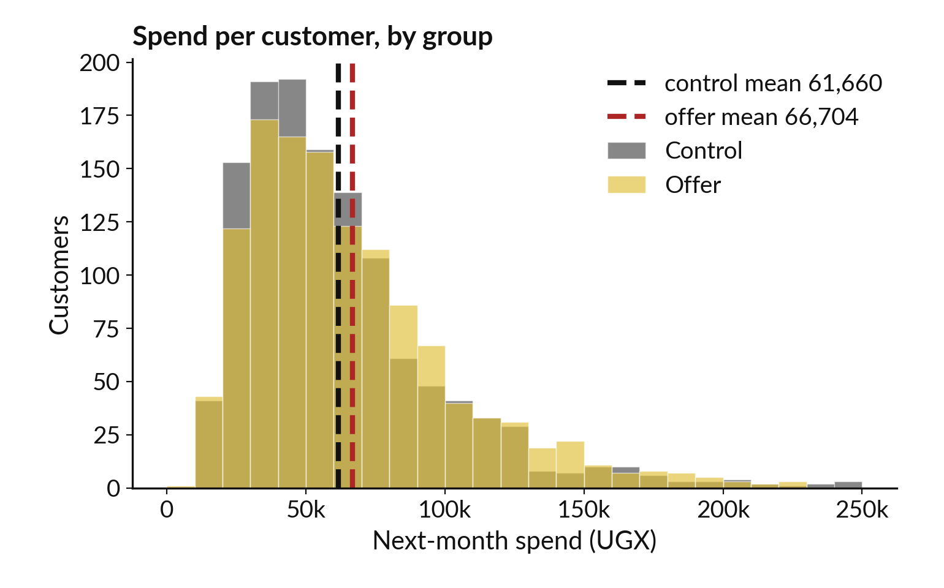
Effect size: the lift is small next
to how much customers differ
The groups overlap heavily. Cohen's d = 0.13, below the usual 0.2 mark for a small effect.
Lift: 5,044 UGX, 8.2 percent of the control mean.
Cohen's d is the lift over the pooled standard deviation, 38,133.
Statistically clear, practically modest.
Notes:
The p-value says chance alone would rarely give a gap this big. It does not say the lift is big. The picture shows the spend of every customer in the two groups, overlapping heavily. The two means are only 5,044 shillings apart, while customers differ from each other by about 38,133.
The effect size is the size of the gap in useful units. In shillings it is 5,044, which is 8.2 percent of the control mean. A standard way to express it is Cohen's d, the lift divided by the pooled standard deviation. Here d is 0.13, which is below the conventional 0.2 mark for a small effect.
A big sample can detect a small effect. Whether it matters is a business question. What would make a gain of eight percent worth having?

Slide 23
Statistical significance and practical
significance answer different questions
Statistical significance
Practical significance
Is the gap bigger than chance? p = 0.00096, below alpha 0.05.
Hypothetical: cost 3,000 UGX per customer, margin 20 percent of extra spend.
20 percent of 5,044 is 1,009, minus 3,000: a loss of 1,991.
Report both: is it real, and is it big enough to act on?
Notes:
These are two different questions. Statistical significance asks whether the gap is bigger than chance, and our p-value of 0.00096 says yes. Practical significance asks whether the gap is big enough to matter for the decision. Suppose, as made-up numbers, the offer costs 3,000 shillings per customer and the shop keeps 20 percent of each extra shilling a customer spends.
Both are hypothetical. The extra spend is revenue, not profit. So 20 percent of the lift of 5,044 is 1,009, and after the cost of 3,000 that is a loss of 1,991 per customer. Even the top of the interval, 8,035, gives only 1,607 at that margin. The gap is real and still not worth buying at that price.
That is a better decision statement than significant or not. What are the real cost and margin in your business?

Slide 24
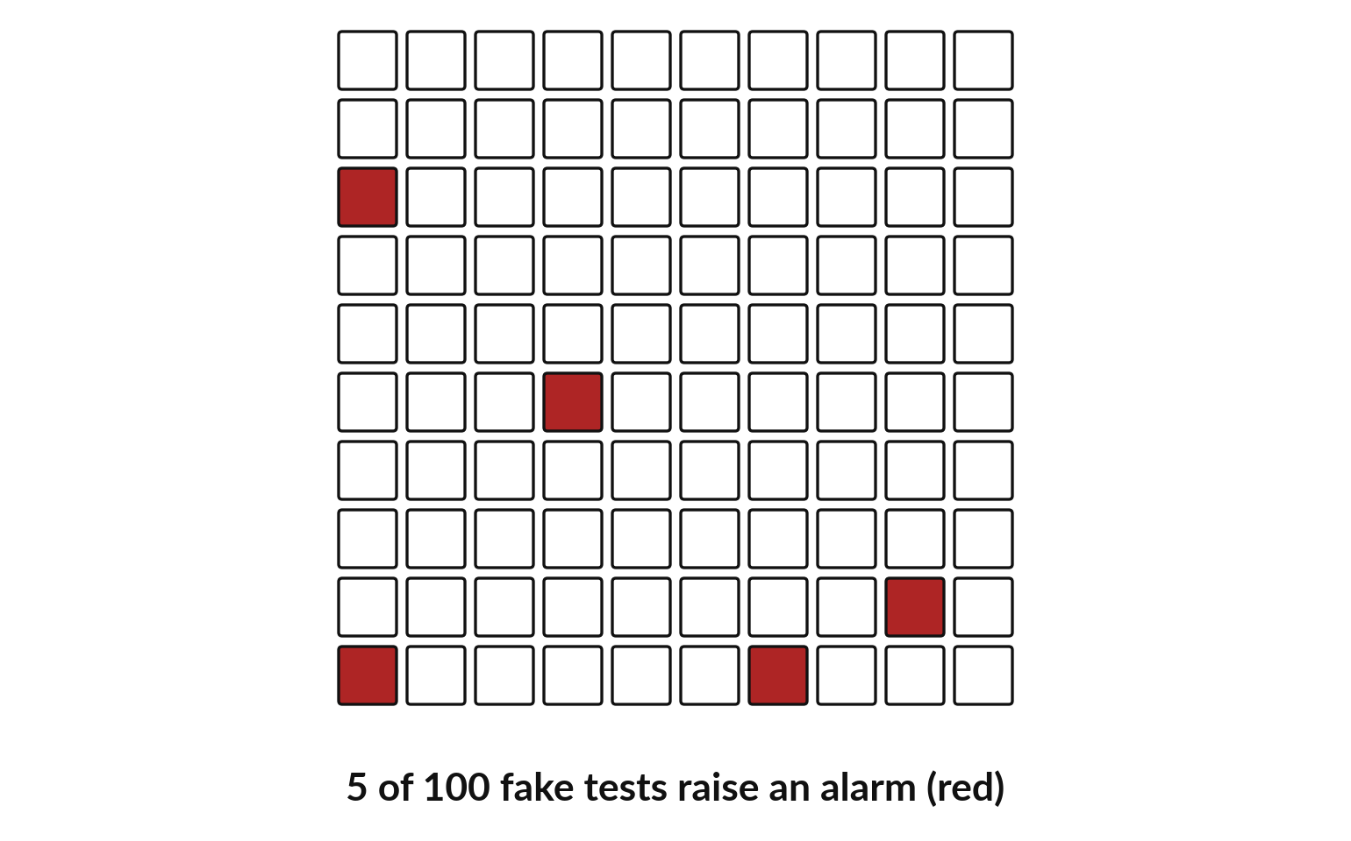
A false positive (Type I error): a test can
raise an alarm when nothing is going on
Alpha = 0.05 means about 5 in 100 tests of a true H0 give p below 0.05.
Fake test: split the control group at random into two halves. The true gap is zero.
5 of 100 splits had p below 0.05.
A false negative (Type II error) is a real effect that a test misses.
Notes:
Here is why alpha matters. We took the control group only, 1,255 customers who all got no offer, and split them at random into two halves. The true gap is zero by construction. Then we ran the t-test on the halves. We did that 100 times. 5 of the 100 tests gave a p-value below 0.05, the red squares.
Each one is a false positive, also called a Type I error: an alarm where nothing is going on. That is exactly what alpha of 0.05 promises, about 5 in 100. The opposite mistake, missing a real effect, is a false negative, or Type II error. If you run one test, five percent is acceptable.
What happens if you run many?

Slide 25
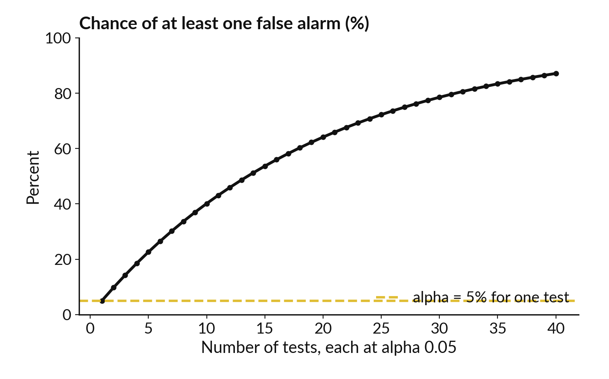
Multiple comparisons: run many
tests and some alarms will be false
With m independent tests at alpha 0.05, the chance of at least one false alarm is 1 minus 0.95 to the power m.
5 tests: 23 percent. 20 tests: 64 percent.
Bonferroni correction: test each at alpha divided by m.
Decide the tests before you look.
Notes:
One test at alpha 0.05 has a five percent chance of a false alarm. Run more, and the chance of at least one false alarm grows quickly. The formula is one minus 0.95 to the power m, for m independent tests. With 5 tests it is 23 percent.
With 10 it is 40 percent. With 20 it is 64 percent, and with 40 it is 87 percent. This is the multiple comparisons problem. Slice the offer test by branch, by age band and by tier, and one slice will look significant by luck. A simple fix is the Bonferroni correction: test each at alpha divided by the number of tests.
Better still, decide the tests before you look. How many slices have you looked at in a report?

Slide 26
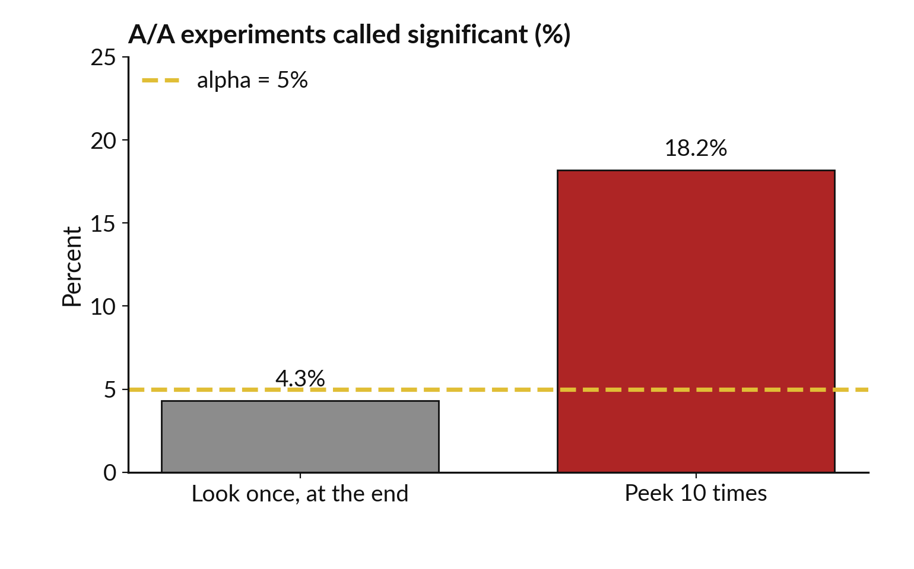
Optional stopping: peeking at a running test and
stopping when p is small inflates false alarms
Decide the sample size in advance. Stopping when p dips below 0.05 is a form of p-hacking.
2,000 A/A experiments, no real difference.
One look at the end: 4.3 percent significant.
Stop at the first of 10 looks with p below 0.05: 18.2 percent.
Notes:
The last trap is peeking. Imagine you run a test and check the p-value every day, and stop the first time it dips below 0.05. That is optional stopping, a form of p-hacking. We simulated 2,000 experiments with no real difference. If you look once, at the planned end, 4.3 percent come out significant, close to the five percent promised.
If you look 10 times and stop at the first small p-value, 18.2 percent come out significant. The p-value was built for a single planned look. So fix the sample size and the tests in advance, write them down, and look once. Have you ever stopped a test early because it looked good?

Slide 27

How many customers does the test need? About
914 per group to catch a lift of 5,000 UGX
Customers per group | Margin of error of the lift (95% interval, plus or minus UGX)
250 | 6,685
500 | 4,727
1,000 | 3,343
1,245 (our offer group) | 2,996
2,500 | 2,114
Margin = 1.96 x s x square root of (2 / n), with s = 38,133 UGX. Power: with 914 per group, a test at alpha 0.05 catches a true lift of 5,000 about 80 times in 100 (power 80 percent, a common choice).
Notes:
A manager will ask how many customers the next test needs. The margin of error of the lift shrinks with the square root of the group size. With 250 customers per group the margin is about 6,685 shillings. With 1,245 per group, like our test, it is about 2,996.
With 2,500 it is about 2,114. Another way to ask is about power: the chance that a test catches a real lift of a given size. Power is one minus the Type II error rate, and 80 percent is a common target. To catch a true lift of 5,000 shillings with 80 percent power at alpha 0.05, you need about 914 customers per group.
Smaller lifts need many more, because halving the lift needs four times the customers. Decide the number before the test starts. What lift would be worth detecting in your business?

Slide 28


Where you will use this at work: check
that a gap is real before you act on it
Your job | The comparison | What today lets you do
Marketing analyst at a telecom, using Python | A promotion sent to half the subscribers. | Report the lift with an interval and a p-value, and the cost per customer.
Credit risk analyst at a bank, using Python | Default rate in two branches or two scorecards. | Run a two-proportion test and report the interval together with the two rates.
Programme officer at an NGO | Test scores in a pilot school and a comparison school. | Use a permutation test when the groups are small or skewed.
Operations manager at a retailer | Return rates before and after a change in supplier. | Fix the test before the data arrive, and avoid peeking.
Notes:
Where will you use this on Monday?
A marketing analyst at a telecom who uses Python can report the lift of a promotion with an interval and a p-value, and set it against the cost per customer. A credit risk analyst at a bank can compare default rates in two branches with a test of two proportions, and report the interval and not only the two rates.
A programme officer at an NGO comparing a pilot school with a comparison school can use a permutation test when the groups are small or skewed. And an operations manager can fix the test before the data arrive and avoid peeking. Which of these is closest to your job?

Slide 29
Read recipe 1 before the lab: the lift, its
standard error, t and the interval by hand
In plain words
import numpy as np
import pandas as pd
test = pd.read_csv('offer_test.csv')
spend = test.next_month_spend_ugx
offer = spend[test.group == 'offer'].to_numpy()
control = spend[test.group == 'control'].to_numpy()
lift = offer.mean() - control.mean()
v_o = offer.var(ddof=1) / len(offer)
v_c = control.var(ddof=1) / len(control)
se = np.sqrt(v_o + v_c)
print(round(lift), round(se), round(lift / se, 2))
print(f'{lift - 1.96*se:.0f} {lift + 1.96*se:.0f}')
Split the spend into offer and control arrays.
v_o and v_c are the squared standard errors. Their sum under a square root is the standard error of the lift.
t is the lift over its standard error: 3.31.
The interval is the lift plus or minus 1.96 standard errors. SciPy ttest_ind with equal_var=False gives the same t.
5044 1526 3.31
2054 8035
Notes:
Before the lab, read the first recipe. It splits the spend into two arrays, offer and control. The lines with v underscore o and v underscore c compute the two squared standard errors, and the square root of their sum is the standard error of the lift. The first print shows the lift, 5,044, the standard error, 1,526, and the t statistic, 3.31.
The second print shows the interval, 2,054 to 8,035. In the lab you will compare these numbers with the SciPy function ttest underscore ind, using equal underscore var equal False, and they should agree. Which line would you change for the control group alone?

Slide 30
Read recipe 2: the bootstrap
interval, with a fixed seed
In plain words
rng = np.random.default_rng(42)
boot = [rng.choice(offer, len(offer)).mean()
- rng.choice(control, len(control)).mean()
for _ in range(5000)]
low, high = np.percentile(boot, [2.5, 97.5])
print(round(low), round(high))
default_rng(42) fixes the seed, so everyone gets the same random draws.
choice with a size draws with replacement. Each pass resamples both groups and takes the lift.
percentile cuts off the lowest and highest 2.5 percent.
The print is the 95 percent bootstrap interval: 1,959 to 8,004.
1959 8004
Notes:
The second recipe is the bootstrap. The default underscore rng call with seed 42 makes the random draws repeat for everyone, so your numbers can match mine. Inside the list, rng dot choice draws a resample of the offer group with replacement, at the original size, and another of the control group.
We take the difference of their means, the lift, and repeat 5,000 times. The percentile call cuts off the lowest and highest 2.5 percent. The print shows the interval, 1,959 to 8,004. It takes a second or two to run. Why does a fixed seed matter when you share a notebook?

Slide 31
Read recipe 3: the permutation
test shuffles the offer labels
In plain words
values = spend.to_numpy()
is_offer = (test.group == 'offer').to_numpy()
rng = np.random.default_rng(42)
gaps = []
for _ in range(5000):
s = rng.permutation(is_offer)
gaps.append(values[s].mean() - values[~s].mean())
hits = (np.abs(gaps) >= abs(lift)).sum()
print(hits, hits / 5000)
values holds every customer spend. is_offer is True for the offer group.
rng.permutation shuffles the labels, keeping the group sizes.
Each shuffle gives one gap in mean spend. hits counts gaps at least as big as the real lift, ignoring the sign.
7 hits in 5,000 gives p = 0.0014.
7 0.0014
Notes:
The third recipe is the permutation test. The array values holds every customer spend, and is underscore offer marks which customers got the offer. Inside the loop, rng dot permutation shuffles those labels at random, which keeps the group sizes. We compute the gap in mean spend for the shuffled groups, and keep it.
After 5,000 shuffles, we count how many gaps are at least as big as the real lift. We use the absolute value, so a big gap in either direction counts. The print shows 7 hits, and a p-value of 0.0014. Where would you shuffle labels in your own data?

Slide 32
Part 2: the Python lab
Close the slides. Open the notebook.
Notes:
That is the end of the ideas. Everything you need is on the slides you have just seen, and the notebook repeats each step. Open Google Colab and open the notebook for Session 12. Run the first cells to load the data. In every step, predict first, then run, then read, then change one thing.
You compute each number by hand with NumPy, and then check it against SciPy or statsmodels. The checks turn from NOT YET to OK when your answer is right.

Slide 33
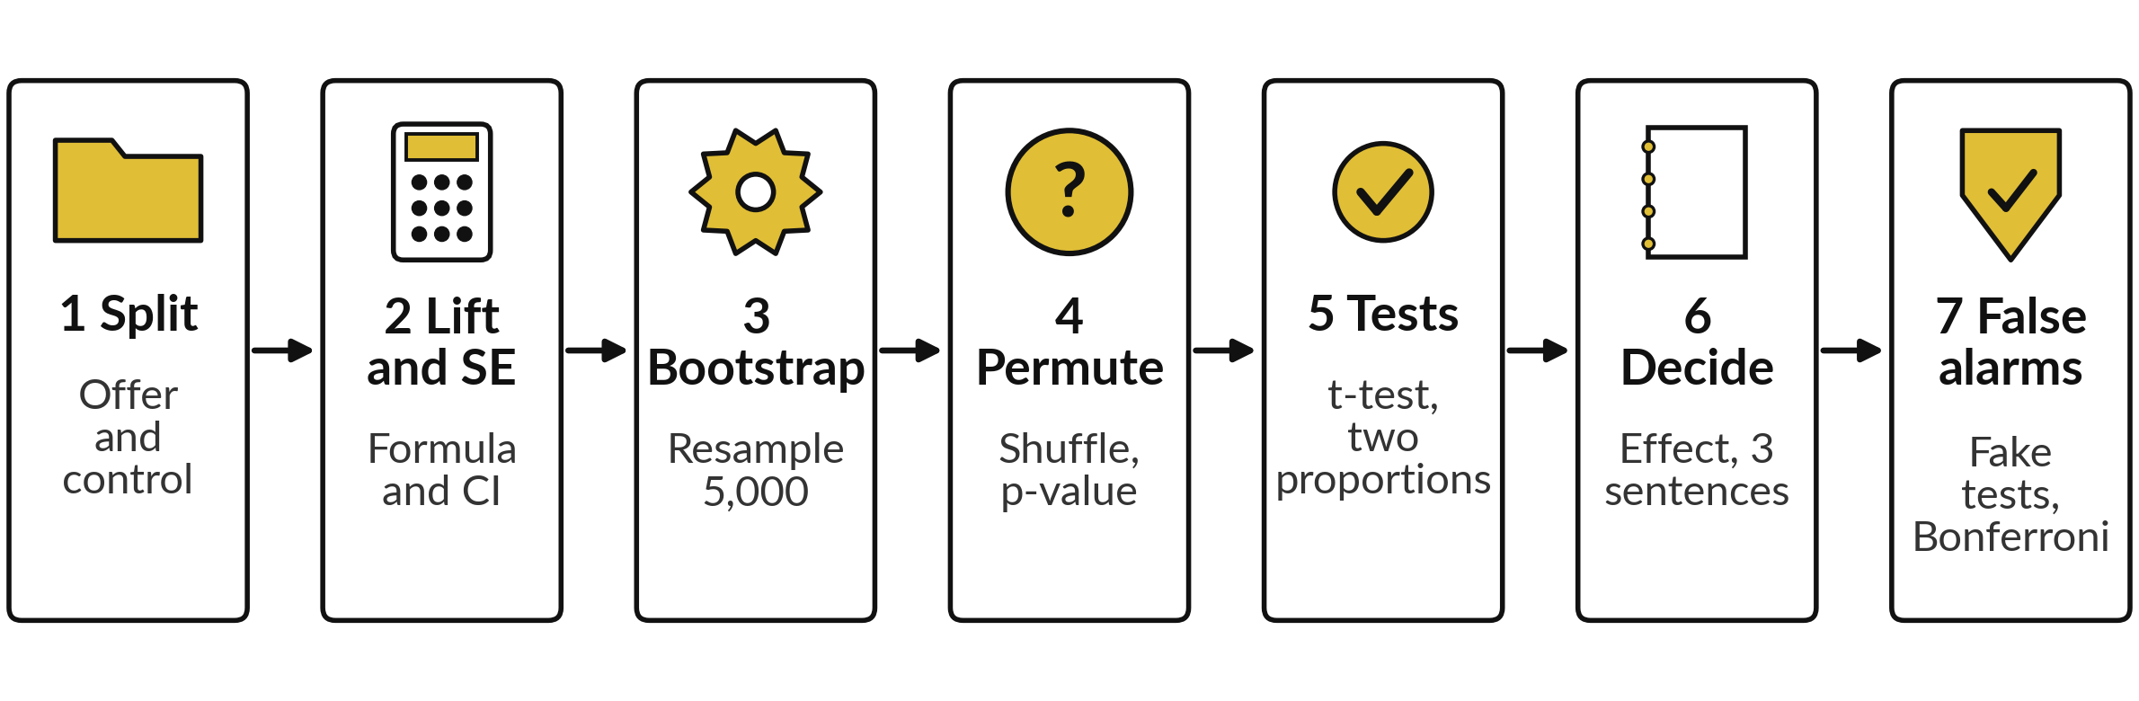
The lab has seven steps, and you
keep a decision note about the offer
Twenty-one automatic checks in 45 minutes. Predict, run, read, change.
Notes:
Here is the map of the lab, in seven steps. Step one, split the spend into offer and control. Step two, compute the lift, its standard error and the formula interval. Step three, bootstrap the lift with a fixed seed. Step four, run the permutation test and get the p-value.
Step five, run the Welch t-test and the test of two proportions with SciPy and statsmodels, and compare them with your by-hand numbers. Step six, compute the effect size and write a decision note of three sentences. Step seven, run 100 fake tests and see about 5 false positives (false alarms), then work out the Bonferroni cut-off. Please write your prediction before every step.

Slide 34








Check your numbers before you move on
What you compute | You should get
Customers in offer and in control | 1,245 and 1,255
Mean spend in offer and in control (UGX) | 66,704 and 61,660
The lift (UGX) | 5,044
Standard error of the lift, and the 95% interval | 1,526, and 2,054 to 8,035
Bootstrap interval (seed 42, 5,000 resamples) | 1,959 to 8,004
Permutation test (seed 42): hits and p-value | 7 of 5,000, p = 0.0014
Welch t statistic and p-value | 3.31 and 0.00096
Two proportions: z and p-value | 1.10 and 0.27
Bootstrap and permutation numbers repeat only with the same seed and the same order of calls.
Notes:
Use this table as your own self-check. Nobody marks it. If your numbers match, carry on. If one does not, stop and call me, because later steps use the earlier ones. The bootstrap and permutation numbers match only if you use the same seed, 42, and the same order of random calls.
If your numbers differ slightly, check the seed first. Do not change a number to make it match. What would a p-value of exactly zero from a permutation test mean?

Slide 35

Five likely mistakes in the lab and how to fix them
What you see | What it means | What to do
Bootstrap interval differs from the slide | A different seed or call order. | Make rng once, before the loop.
p-value is 0.0 from the permutation test | No shuffle was this extreme. | Report p below 1 in 5,000.
NameError: name 'stats' is not defined | The import cell was not run. | Run the first code cell: from scipy import stats.
t is 0.002 instead of 3.31 | The lift was divided by the variance. | Take the square root: np.sqrt(v_o + v_c).
p-value is half of the expected value | A one-sided test was run. | Use the two-sided p-value: multiply the tail area by 2.
Notes:
Five problems you may meet. If your bootstrap interval differs from the slide, you used a different seed or made the draws in a different order, so create the random generator once, before the loop. If the permutation p-value is zero, no shuffle was as extreme in 5,000 tries, so report that it is below one in 5,000 and never write exactly zero.
A name error for stats means the import cell was not run. A t statistic close to zero, like 0.002, usually means you divided by the variance instead of the standard error, so take the square root. And a p-value that is half what you expected means a one-sided test. Read the message first. It usually tells you the answer.

Slide 36
Exit check: three questions, then
compare with the short answers
Question | Short answer
A test gives p = 0.03 with alpha = 0.05. What do you conclude, and what do you still need to report? | Reject H0: if H0 were true, a gap this big would be rare. Also report the effect size and the confidence interval.
You run 20 tests at alpha = 0.05 on a dataset with no real effects. About how many false positives do you expect? | About one, because 20 times 0.05 is 1. The chance of at least one is about 64 percent.
A 95 percent confidence interval for the lift is -200 to 5,000 UGX. Is the lift significant at 0.05? | No. The interval includes zero, so the data are compatible with no difference.
Notes:
Last, the exit check. Write your answers before you look at mine. One, a test gives a p-value of 0.03 with alpha 0.05: what do you conclude, and what else do you report?
Two, you run 20 tests at alpha 0.05 on data with no real effects: about how many false positives do you expect?
Three, a 95 percent interval for a lift runs from minus 200 to 5,000 shillings: is the lift significant?
The short answers are on the slide. If you got all three, you are ready for Session 13.

Slide 37
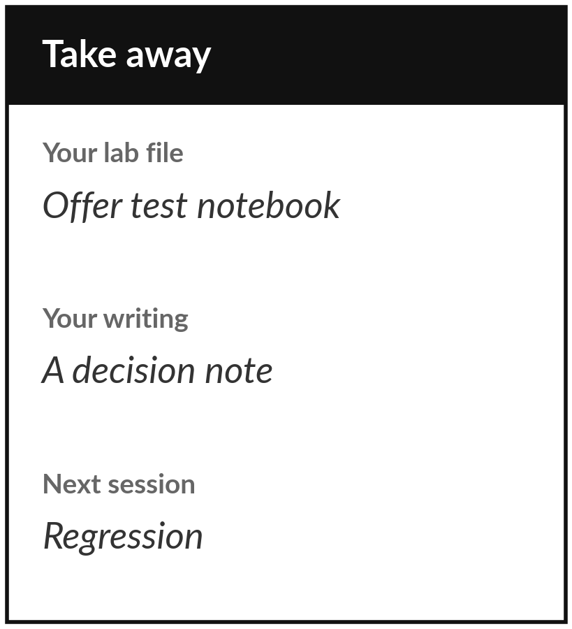
Save your notebook with its decision note
What you keep from today
Keep your inference notebook: the offer test done five ways (formula, bootstrap, permutation, t-test, two proportions) and a decision paragraph with the lift, its interval, the p-value and the limit.
Our question today
When two groups differ, how do I know the gap is real and that chance does not explain it?
Next session
Session 13: Regression. How much does one thing change when another changes? We model weekly orders and reach Project milestone 2.
Notes:
Before you go, save your notebook with the decision note. That paragraph is the keepsake from today: it states the lift, its confidence interval, the p-value, the effect size and one limit, in words a manager can use. Check that you could defend each number. Next session we move from comparing two groups to modelling a number with regression, and it brings Project milestone 2.
If anything about p-values is still unclear, write the question down and bring it.
We began with this question: When two groups differ, how do I know the gap is real and that chance does not explain it? Before you go, say in one sentence what you can now say about it.

